Slide 1


S.O.L.I.D. Software Development
12 January 2010
(Martin Verboon, Patrick Kalkman, Stan Verdiesen)

Slide 2

S.O.L.I.D. software development
Software development is not a Jenga game!
12 january 2010
S.O.L.I.D. software development

Slide 3
Intention of this meeting
Hand out concrete tips that can help during (software) design and development by introducing S.O.L.I.D. design principles
12 january 2010
S.O.L.I.D. software development

Slide 4
Agenda
Introduction
Theory
  Single Responsibility Principle (SRP)
  Open-Closed Principle (OCP)
  Dependency Inversion Principle (DIP)
Interactive workshop
Presenting workshop results
Conclusion
15 min.
20 min.
15 min.
10 min.
12 january 2010
S.O.L.I.D. software development

Slide 5
Introduction – why necessary?
S.O.L.I.D. is useful as reference while designing applications
Managing dependencies makes maintainability easier
  Consists of creating dependency ‘firewalls’
Various principles and techniques available for building dependency firewalls
12 january 2010
S.O.L.I.D. software development

Slide 6
Introduction – helpful principles
Principles of object oriented (class) design:
  Single Responsibility Principle (SRP)
  Open-Closed Principle (OCP)
  Liskov Substitution Principe (LSP)
  Interface Segregation Principle (ISP)
  Dependency Inversion Principle (DIP)
12 january 2010
S.O.L.I.D. software development

Slide 7
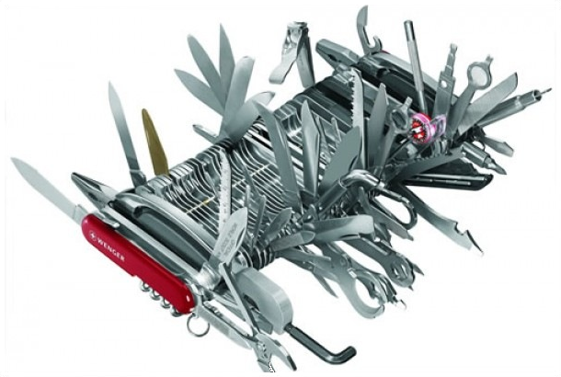
Single Responsibility Principle (SRP)
Just because you can, doesn’t mean you should
12 january 2010
S.O.L.I.D. software development

Slide 8
Single Responsibility Principle (SRP)
“There should never be more than
one reason for a class to change”
Simplest principle, hardest to get right
Finding and separating responsibilities may be hard to do
When violated: fragile design that breaks in unexpected ways when changed
12 january 2010
S.O.L.I.D. software development

Slide 9
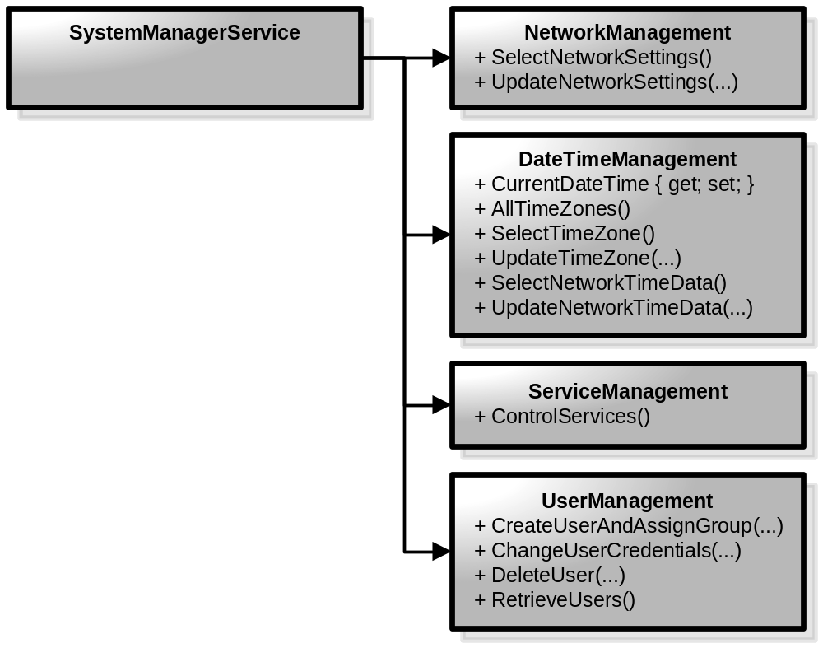
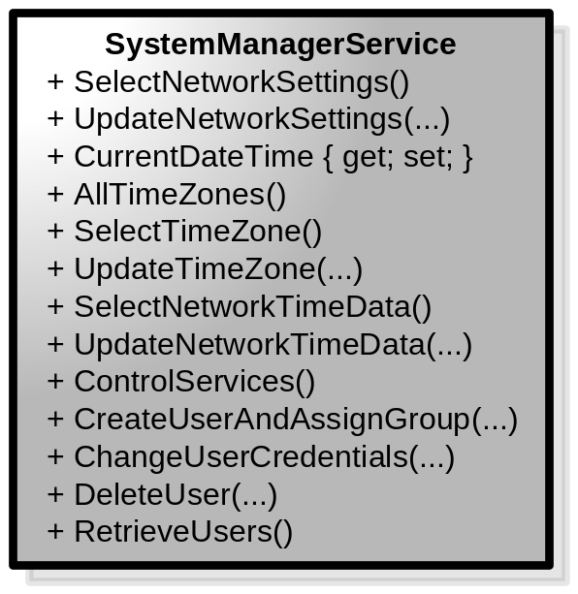
Single Responsibility Principle (SRP)
12 january 2010
S.O.L.I.D. software development

Slide 10
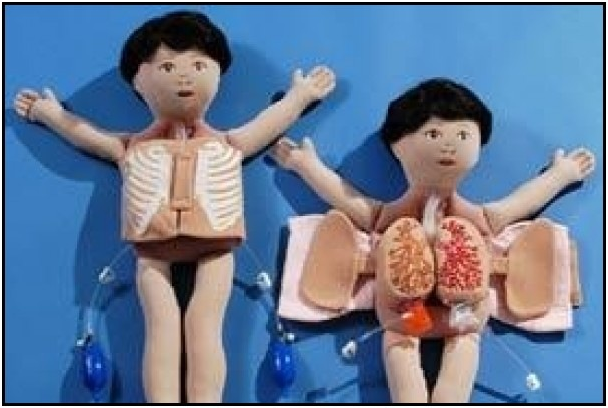
Open-Closed Principle (OCP)
Open chest surgery is not needed when putting on a coat
12 january 2010
S.O.L.I.D. software development

Slide 11
Open-Closed Principle (OCP)
“Software entities should be open for extension, but closed for modification”
Abstraction is the key
Extend behavior instead of changing old code that already works → reusability and maintainability
When violated: cascading changes to dependent modules during changes
12 january 2010
S.O.L.I.D. software development

Slide 12
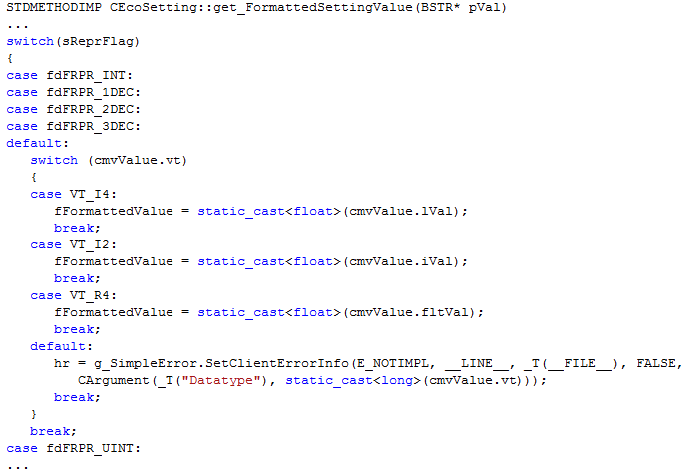
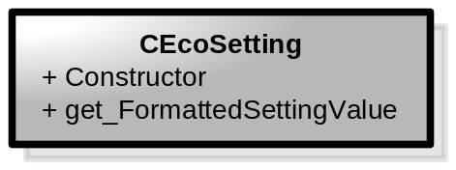
Open-Closed Principle (OCP)
Adding new interval requires switch to change = changing working code
Adding new interval requires switch to change = changing working code
Adding new types requires switch to change = changing working code
12 january 2010
S.O.L.I.D. software development

Slide 13
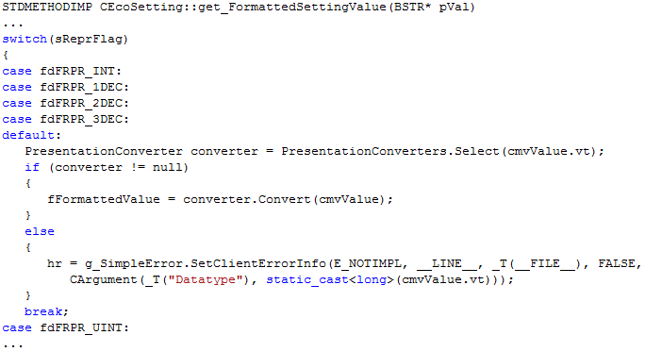
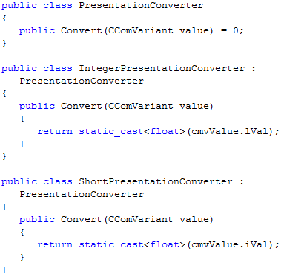
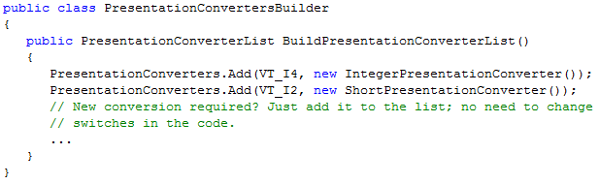
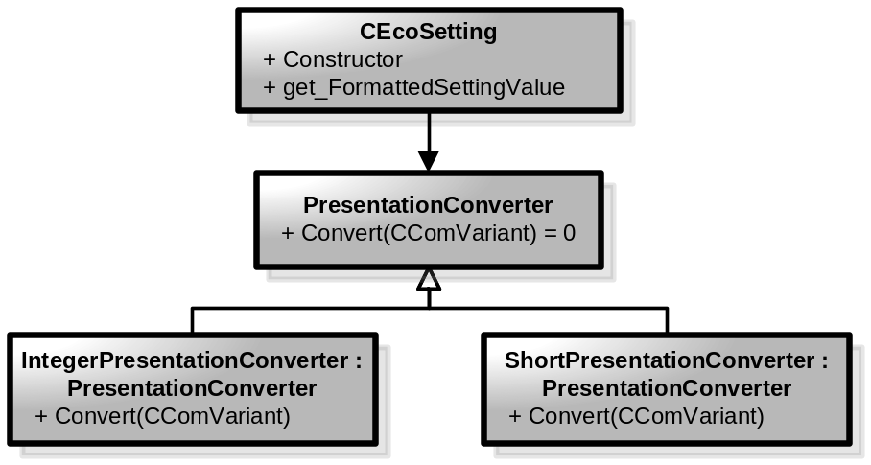
Open-Closed Principle (OCP)
Step 1
12 january 2010
S.O.L.I.D. software development

Slide 14
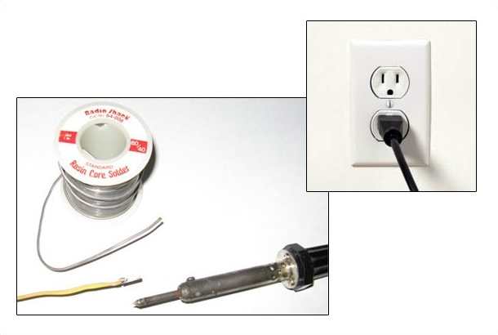
Dependency Inversion Principle (DIP)
Would you solder a lamp directly to the electrical wiring in a wall?
12 january 2010
S.O.L.I.D. software development

Slide 15
Dependency Inversion Principle (DIP)
“Depend upon abstractions;
Do not depend upon concretions”
High level modules should:
  depend upon abstraction of low level modules
  force low level modules to change
When violated: lower level module changes can force high level modules to change
12 january 2010
S.O.L.I.D. software development

Slide 16
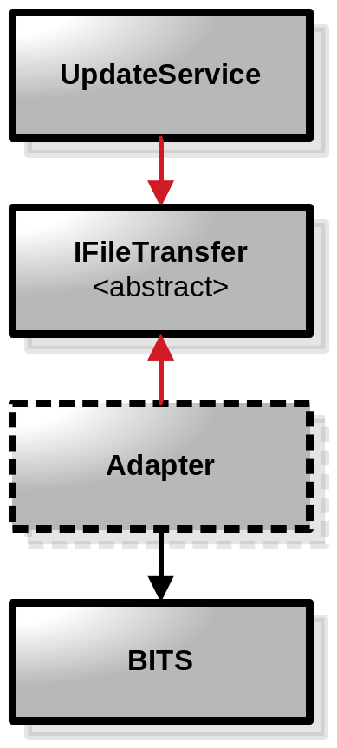
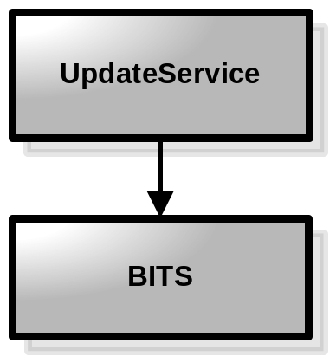
Dependency Inversion Principle (DIP)
BITS = Background Intelligent Transfer System; for downloading updates
12 january 2010
S.O.L.I.D. software development

Slide 17
Workshop introduction
Examples are handed out to every group
Write down found principles on given paper; including possible solution
Hang up paper when finished
Maximum of 20 minutes
Presentation of results
12 january 2010
S.O.L.I.D. software development

Slide 18
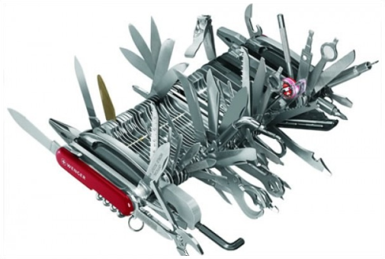

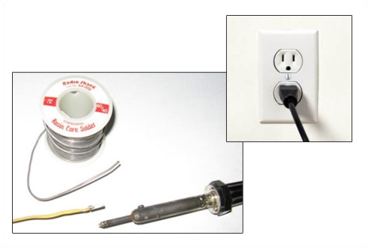
Interactive workshop
2 examples + 1 optional example
Write results on paper
Hang up paper when finished
Time limit: 20 minutes
-
12 january 2010
S.O.L.I.D. software development

Slide 19

Workshop results
12 january 2010
S.O.L.I.D. software development

Slide 20
Conclusion
SOLID design principles not new but provide concrete checklist
Start by recognizing SOLID principles
Also read the (L)SP and the (I)SP principles
Can be used when creating new designs
Can be used to improve existing designs
12 january 2010
S.O.L.I.D. software development

